Slide 1


Constraint Layout & Realtime Database with Cloud Firestore

Slide 2

Pankaj Rai
Software Engineer, PurpleTalk India Pvt Ltd

Slide 3
Agenda
What’s new in constraint layout
Existing functionalities in constraint layout
Get started with Cloud Firestore

Slide 4
Why Constraint Layout?

Slide 5
Create Responsive UI
Improve performance
Create complex UI with flat hierarchy

Slide 6
What’s new in constraint layout

Slide 7
Barrier
Percent Dimension
Circular Positioning
Placeholder
Group

Slide 8
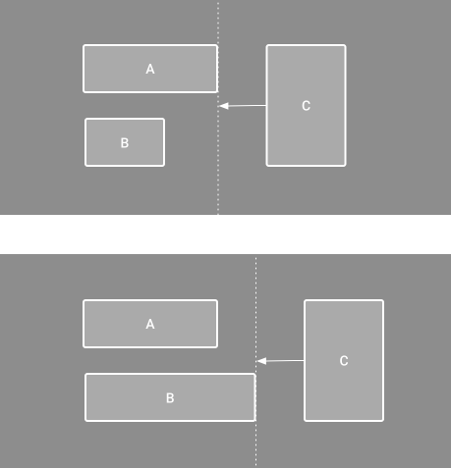
Barrier
A barrier creates virtual guideline
based on the most extreme widget
on the specified side.

Slide 9
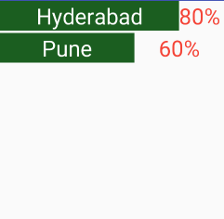
Percent Dimension
Percent dimension defines the width and
height of the view in terms of percentage
rather than fixed values in dp.

Slide 10
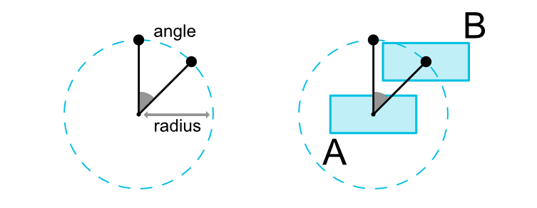
Circular Positioning
Align any view relative to another view, at some angle and at a distance.

Slide 11
Placeholder
Group
It’s a virtual container whose content can be changed dynamically to display some existing view.
It control visibility for a set of referenced views.

Slide 12
Existing Functionalities in Constraint Layout

Slide 13
Bias
Ratio
Chains

Slide 14
Bias
Ratio
Chains
Align view with the corresponding view based on some percentage. Alignment can be done either horizontally or vertically.
Define one dimension of the view as ratio of the other one.
It provide a group like access on a single axis either horizontally or vertically.

Slide 15
Let’s Code

Slide 16
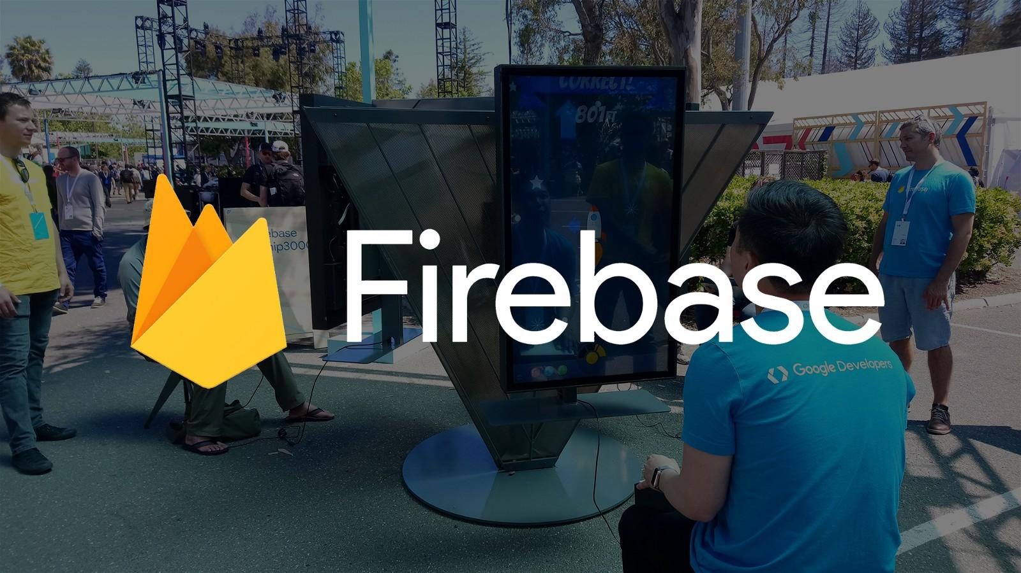

Slide 17
Firebase is Google’s mobile platform to develop high quality apps, grow user base and earn money.
Easy to integrate on Android, iOS and Web.
Multiple services that works together.

Slide 18
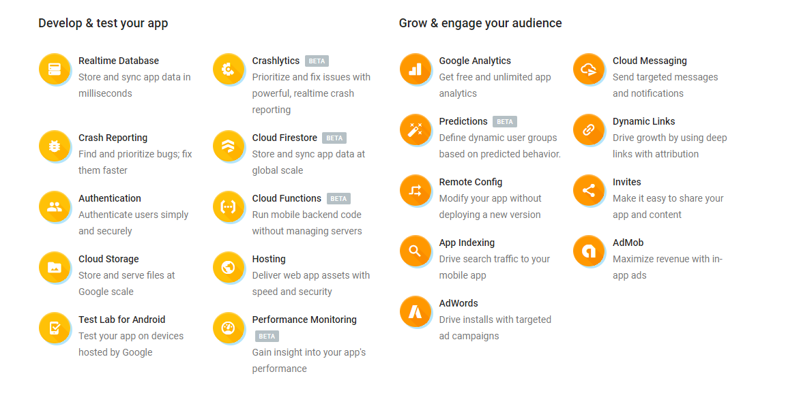

Slide 19


Slide 20
Cloud Firestore
It’s NoSQL document database for mobile and web app development.
Cloud Firestore also offers seamless integration with other Firebase and Google Cloud Platform products, including Cloud Functions.
It keeps your data in sync across client apps through realtime listeners and offers offline support for mobile and web.

Slide 21
Key Features
Documents and collections with powerful querying.
Android, iOS and Web SDKs with offline data access.
Real-time data synchronization.
Automatic, multi-region data replication with strong consistency.
Node, Python, Go and Java server SDKs.

Slide 22
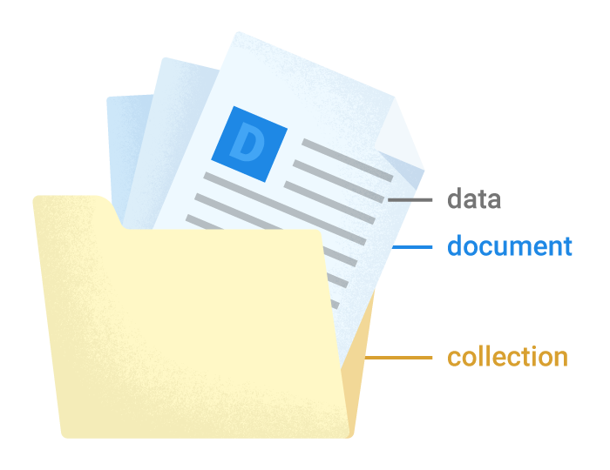
Documents
It’s the smallest unit to store data in the database more set of data type are now supported with document
Documents have some restrictions although
Document cannot contain another document.
Document may points to subcollections.
Document can only store data with limited data type where null is now supported.
Each document must have a unique document id.
Document have to be inside a collection.

Slide 23
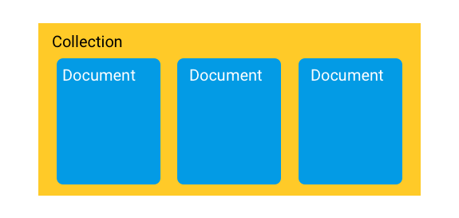
Collections
Collections are like a container which itself doesn’t store any data but contains document which in turn stores data.
There are few set of restriction on collections
It cannot store another collection.
Collection cannot store data on it’s own.
Each collection should have unique id.
Deleting any document will not delete the subcollection it was pointing to.

Slide 24
Write to
database
Set
Required reference to the document where document name can be provided, if document name is skipped then a document with random name get created.
Add
Required reference to the collection and document name is auto generated.
Update
Required reference to the document where certain field can be updated.

Slide 25
Read from
database
Get
When used with collection returns all available document inside collection. When used with document returns all it’s content.
Add Snapshot Listener
Retrieve and set listener to get real-time
data.

Slide 26
Thank You
Pankaj Rai
https://medium.com/@pankaj.rai16 https://www.linkedin.com/in/pankajrai16/

